Slide 1
Managing Disks and Filesystems

Slide 2
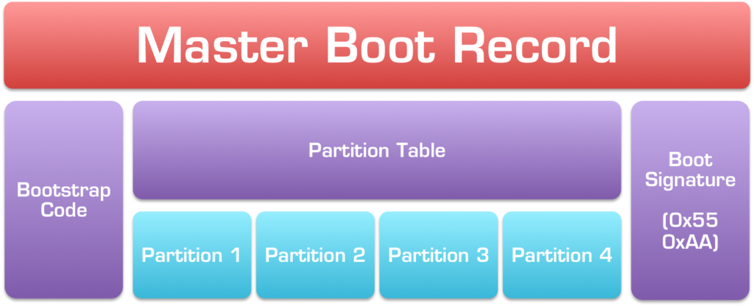
Partitioning Hard Disks
Understanding partition tables
Master Boot Record (MBR) partition tables(BIOS)
Globally Unique Identifier (GUID) partition tables(UEFI)

Slide 3
partitioning tools
parted(for GUID partition tables)
fdisk(for MBR partition tables)

Slide 4
Viewing disk partitions
#parted -l /dev/sda
# fdisk -l /dev/sdb
A SCSI or USB storage device is represented by an sd? Device
A NVMe SSD storage device is represented by a nvme device
When a USB flash drive is inserted, it is assigned to the next available sd device.

Slide 5
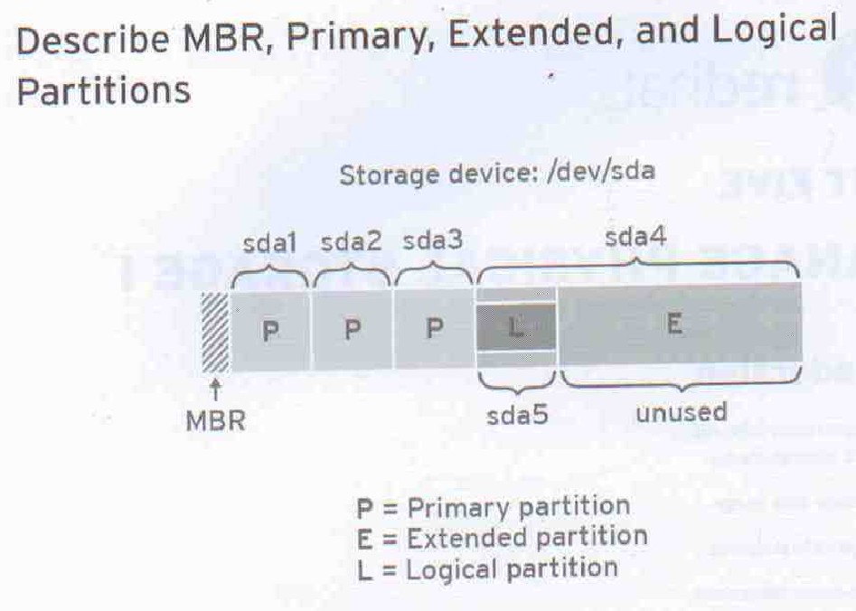

Slide 6
Creating a single-partition disk
Install the new hard drive or insert the new USB flash drive.
Partition the new disk.
Create the filesystems on the new disk.
Mount the filesystems.

Slide 7
The mount command mounts a storage device or filesystem, making it accessible and attaching it to an existing directory structure.

Slide 8
mount [OPTION...] DEVICE_NAME DIRECTORY
#mount /dev/sdb1 /mnt/media
#mount -t ext4 /dev/vdb1 /mnt
# mount -o loop CentOS-6.5-x86_64-bin-DVD1.iso /mnt/iso
# umount /dev/hda6
# umount /dev/sdb1

Slide 9
mkfs -t [fs type] [target device]
mkfs.[fs type] [target device]
File sytem type
FAT*
NTFS
APFS
HFS*
ext*
#mkfs /dev/sdb1
#mkfs -t ext4 /dev/sdb1
#mkfs.ext4 /dev/sdb1

Slide 10
Open each device whose partition table must be (re)created with:
# parted /dev/sdx
To then create a new GUID Partition Table, use the following command:
(parted) mklabel gpt
To create a new Master Boot Record/MS-DOS partition table instead, use:
(parted) mklabel msdos

Slide 11
(parted) mkpart part-type-or-part-label fs-type start end
part-type-or-part-label is interpreted differently based on the partition table:
MBR: the parameter is interpreted as part-type, which can be one of primary, extended or logical.
GPT: the parameter is interpreted as part-label, which sets the PARTLABEL attribute of the partition.

Slide 12
Creating a multiple-partition disk
# fdisk /dev/sdb
#grep sdb /proc/partitions
#partprobe /dev/sdb
#grep sdb /proc/partitions
#mkfs -t ext4 /dev/sdb1
……

Slide 13
Using Logical Volume Manager Partitions
Logical Volume Manager (LVM) offers lots of flexibility and efficiency in dealing with constantly changing storage needs.
With LVM, physical disk partitions are added to pools of space called volume groups.
Logical volumes are assigned space from volume groups as needed

Slide 14
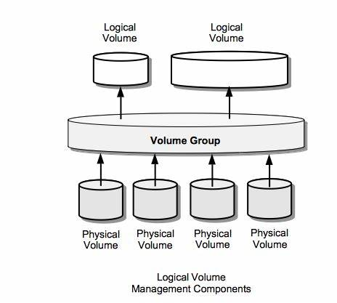

Slide 15
Checking an existing LVM
fdisk -l /dev/sda | grep /dev/sda
Disk /dev/sda: 160.0 GB, 160000000000 bytes
/dev/sda1 * 2048 1026047 512000 83 Linux
/dev/sda2 * 1026048 312498175 155736064 8e Linux LVM
#pvdisplay /dev/sda2
#vgdisplay vg_abc
#lvdisplay vg_abc

Slide 16
Creating LVM logical volumes
LVM logical volumes are used from the top down, but they are created from the bottom up.
first you create one or more physical volumes (pv), use the physical volumes to create volume groups (vg), and then create logical volumes from the volume groups (lv).

Slide 17
pvcreate [Physical Volume Name] pvs or pvdisplay
vgcreate [Volume Group Name] [Physical Volume Name] vgs [Volume Group Name] or vgdisplay [Volume Group Name] vgextend [Existing Volume Group Name] [Physical Volume Name]
lvcreate –n [Logical Volume Name] –L [Logical Volume Size] [Name of the Volume Group where the LV to be created] lvs /dev/[Name of the Volume Group where LV resides]/[LV name] or lvdisplay /dev/[Name of the Volume Group where LV resides]/[LV name]
mkfs –t [File System Type] /dev/[Name of the Volume Group where LV resides]/[LV name]
mount DEVICE_NAME DIRECTORY
df -h DIRECTORY

Slide 18
create a disk partition on it of the LVM type (8e). Then use the pvcreate command to identify this partition as an LVM physical volume. # pvcreate /dev/sdb6
To add that physical volume to a new volume group, use the vgcreate command. vgcreate myvg0 /dev/sdc6
To see the new volume group, type the following: # vgdisplay myvg0
create a logical volume from some of the space in that volume group lvcreate -n music -L 1G myvg0 ls /dev/mapper/myvg0*
reate filesystem and mount # mkfs -t ext4 /dev/mapper/myvg0-music # mkdir /mnt/mymusic # mount /dev/mapper/myvg0-music /mnt/mymusic

Slide 19
# vgdisplay myvg0
# lvextend -L +1G /dev/mapper/myvg0-music
# resize2fs -p /dev/mapper/myvg0-music
# df -h /mnt/mymusic/ 查看磁盘的信息（推荐）

Slide 20
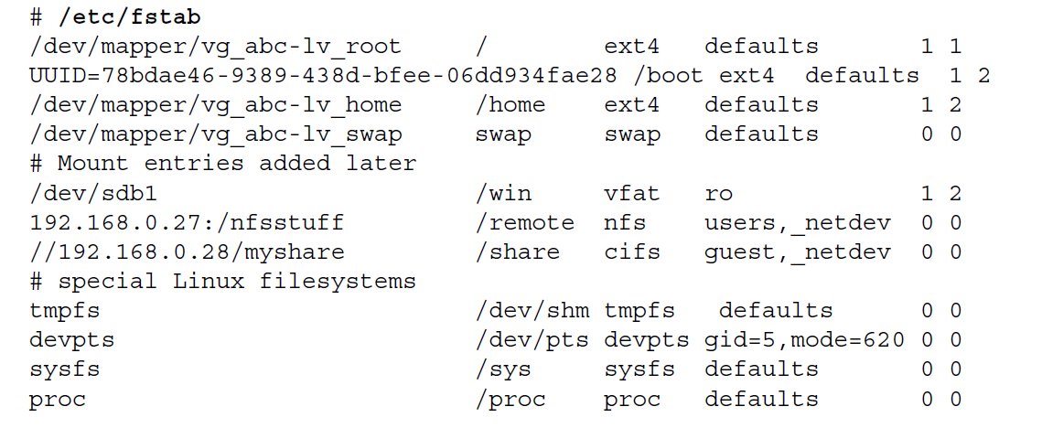
Using the fstab file to define mountable file systems

Slide 21
